Slide 1


Virtual reality
Zavaruev Ivan
PI19-1v

Slide 2

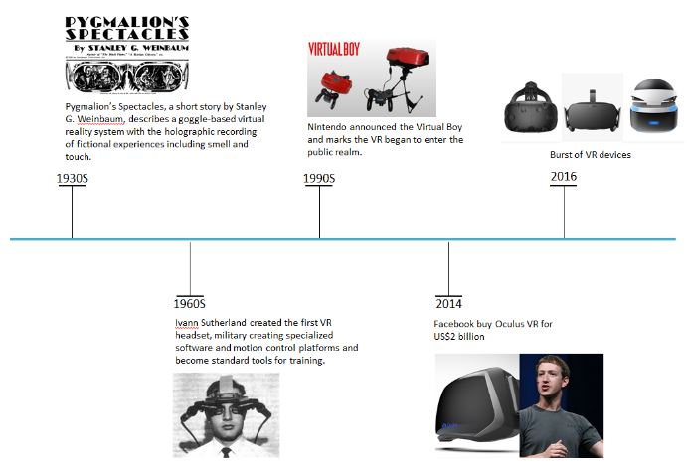

history

Slide 3
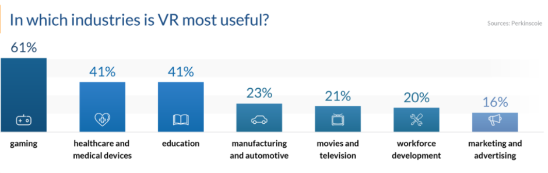
usage

Slide 4
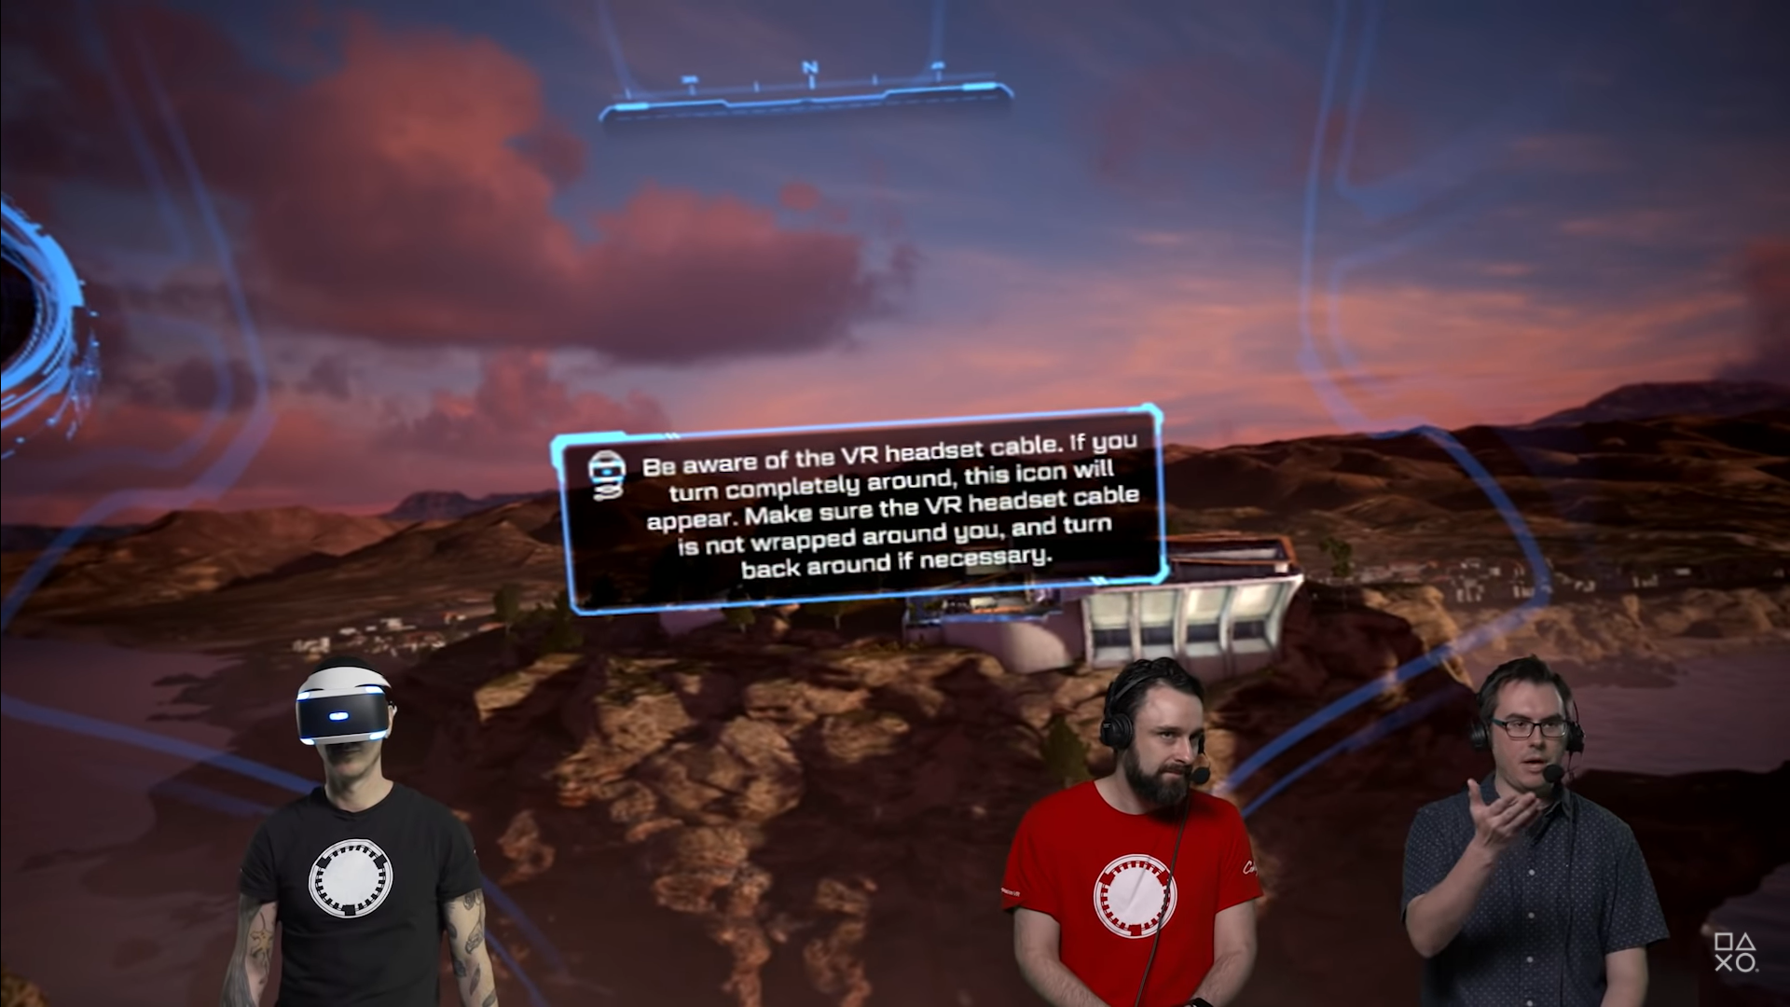
Gaming

Slide 5
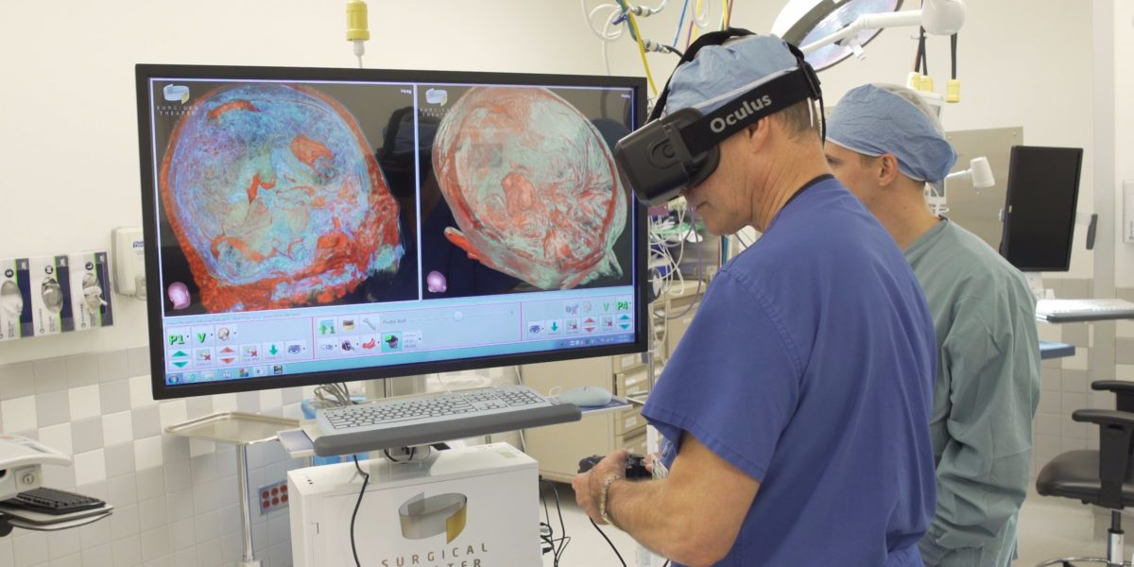
Healthcare

Slide 6
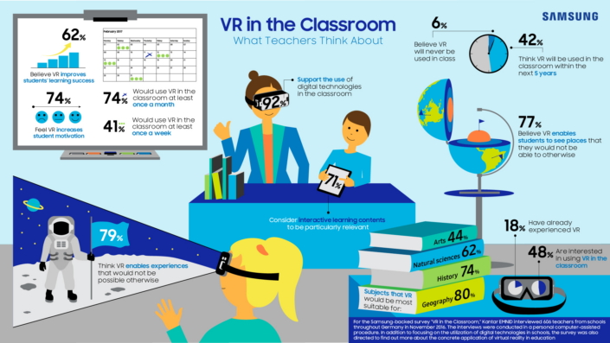
education

Slide 7
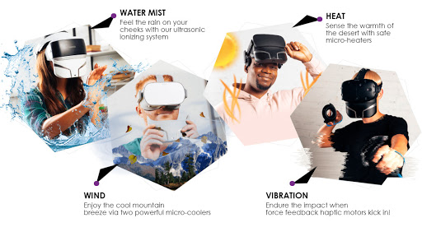
future

Slide 8
Thanks for your attention

